Slide 1

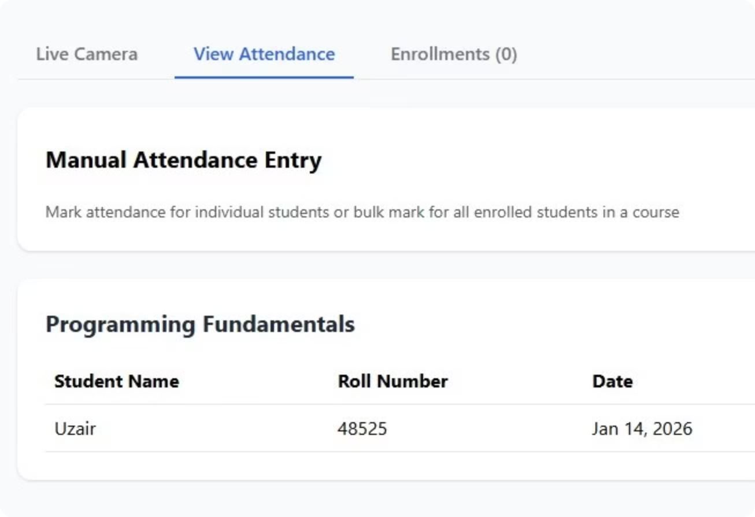

Attendify
Presented by:
Daniyal Wajid (48528)
Uzair Hassan (48525)
BSSE-7
Riphah International University

Slide 2
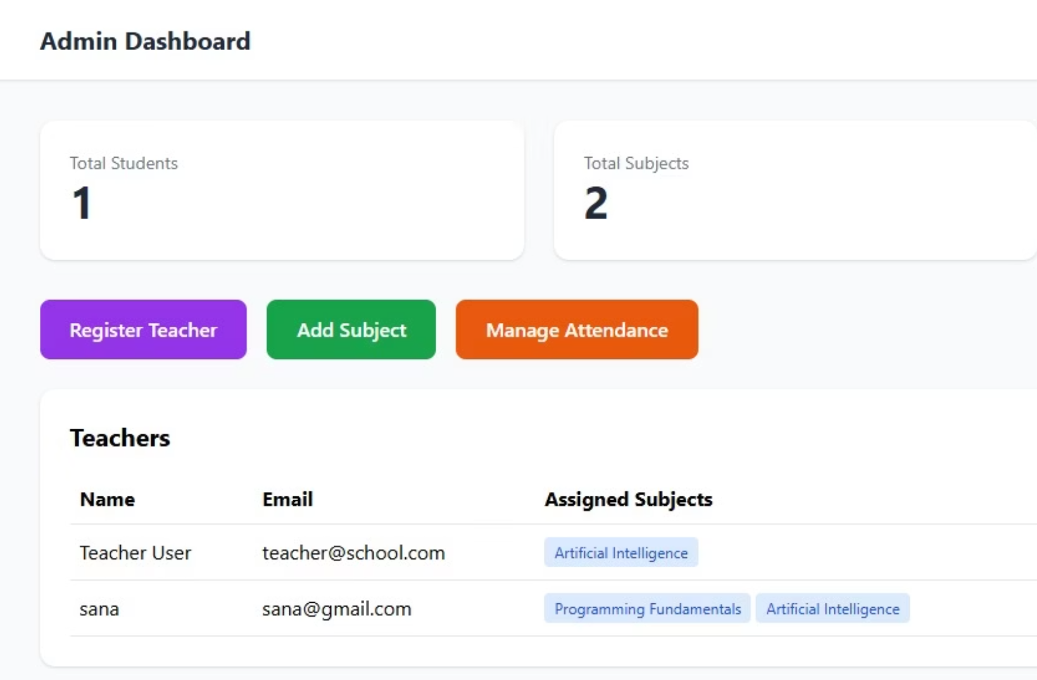
INTRODUCTION
Revolutionizing Attendance Management
Traditional manual attendance methods are plagued by inefficiencies and a high potential for errors, often consuming valuable class time.
Leveraging advancements in artificial intelligence and computer vision, we introduce an automated solution. This system precisely identifies individuals using state-of-the-art face recognition from short video clips.
Our fully web-based solution offers a modern, intuitive dashboard for seamless management and monitoring.

Slide 3
CHALLENGE
Addressing the Pitfalls of Traditional Attendance
1
2
Time-Consuming Process
Proxy Attendance Issues
Manual roll calls disrupt class flow and waste precious instructional time, leading to decreased productivity.
The prevalence of proxy attendance undermines academic integrity and distorts accurate record-keeping.
3
4
Poor Scalability
Lack of Security
Managing attendance for large classes or multiple sections becomes an overwhelming and error-prone task for instructors.
Manual systems are vulnerable to manipulation and provide insufficient security for sensitive attendance data.

Slide 4

GOALS
Key Objectives for a Smarter System
Automate Attendance with AI
Video Dataset Training
Capture Multiple Face Angles
Train the AI model using 10-second student video clips for robust recognition.
Implement intelligent algorithms for reliable and instant student identification.
Ensure comprehensive data capture to enhance accuracy across various orientations.
Web-Based Dashboard
Secure Data Management
Develop an intuitive, user-friendly interface for seamless attendance management.
Establish robust protocols for storing and safeguarding sensitive student and attendance data.

Slide 5

HOW IT WORKS
Seamless Flow: From Registration to Recognition
Register
Capture
Frame
Train
Recognize
Our system simplifies the entire attendance process, ensuring accuracy and efficiency at every step.

Slide 6





ARCHITECTURE
Methodology & System Design
Registration & Video Capture
Students register via the web app, submitting short video clips through their webcam for initial enrollment.
Frame Extraction & Angle Detection
Videos are processed into individual frames, analyzed to detect and capture multiple facial angles.
Model Training & Face Embeddings
An AI model is trained on these diverse frames, creating unique face embeddings for each student.
Live Camera Recognition
During class, a live camera feed uses the trained model to identify students in real-time.
Attendance Storage
Once identified, attendance records are securely stored and managed within a centralized database.

Slide 7
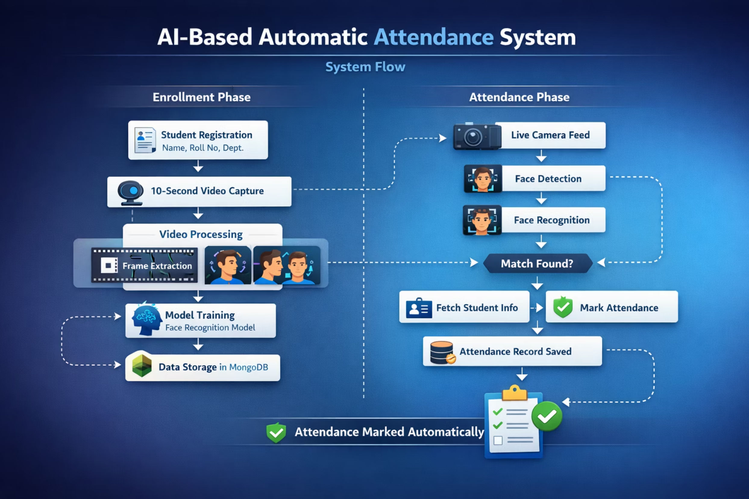
Flow of the system

Slide 8
TOOLS
Technology Stack Powering the System
Frontend
Backend
Database
React.js for dynamic UI, Tailwind CSS & PostCSS for modern styling.
Node.js handles server-side logic, with Express.js for robust API development.
MongoDB provides a flexible and scalable solution for data storage.
AI Core
Integrations
Advanced Face Recognition and Computer Vision algorithms for accurate detection.
Webcam & REST APIs ensure seamless communication and functionality.

Slide 9
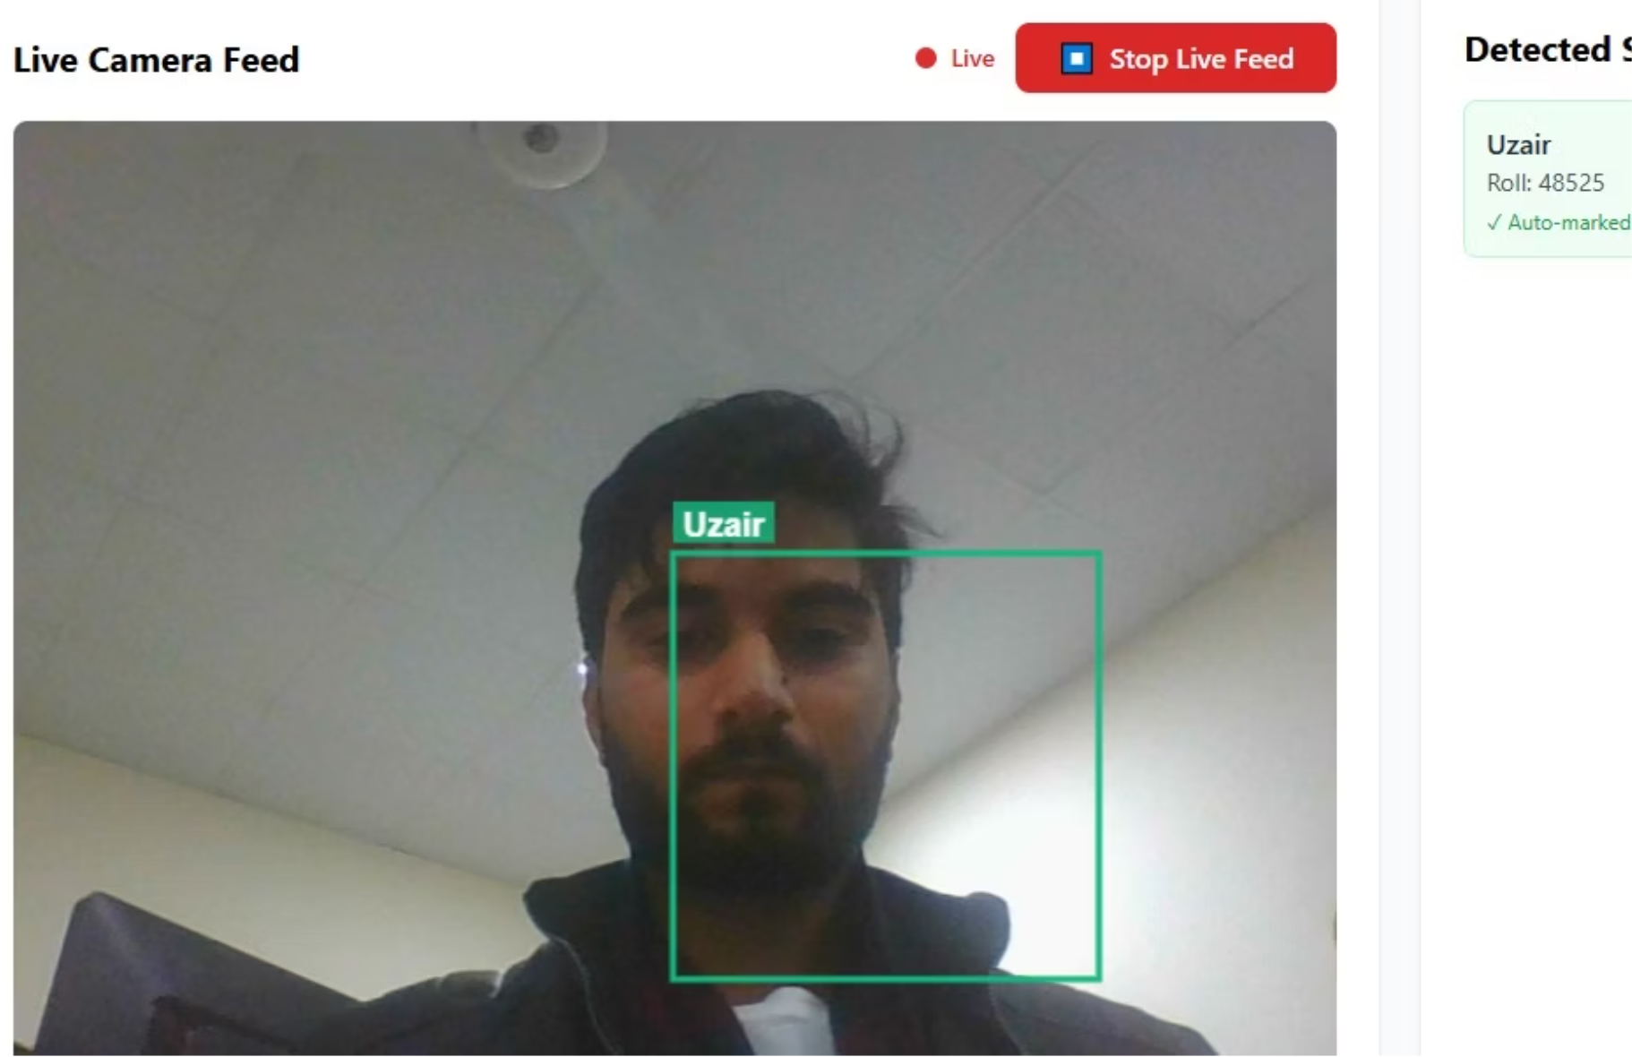
DEVELOPMENT
Bringing the System to Life
Modern React Dashboard UI: Designed for optimal user experience with an intuitive and responsive interface.
Student Registration with Video Input: A streamlined process for students to enroll, including video capture for facial data.
MongoDB for Data Storage: Securely stores all student information, video embeddings, and attendance records.
Live Camera Detection: Integrates real-time camera feeds to identify students present in the classroom.
Automated Attendance Marking: Once a student is identified, their attendance is recorded instantly and accurately.

Slide 10
OUTCOMES
Transforming Attendance: Tangible Benefits
High Recognition Accuracy
Real-time Attendance Marking
Reduced Manual Effort
Multi-angle data training ensures precise and reliable student identification.
Instant recording of presence, eliminating delays and improving data freshness.
Automates tedious tasks, freeing up instructors' time for teaching and interaction.
Improved Security & Reliability
Scalable for All Classrooms
Minimizes proxy attendance and human error, providing dependable records.
Designed to handle varying class sizes, from small seminars to large lecture halls.

Slide 11


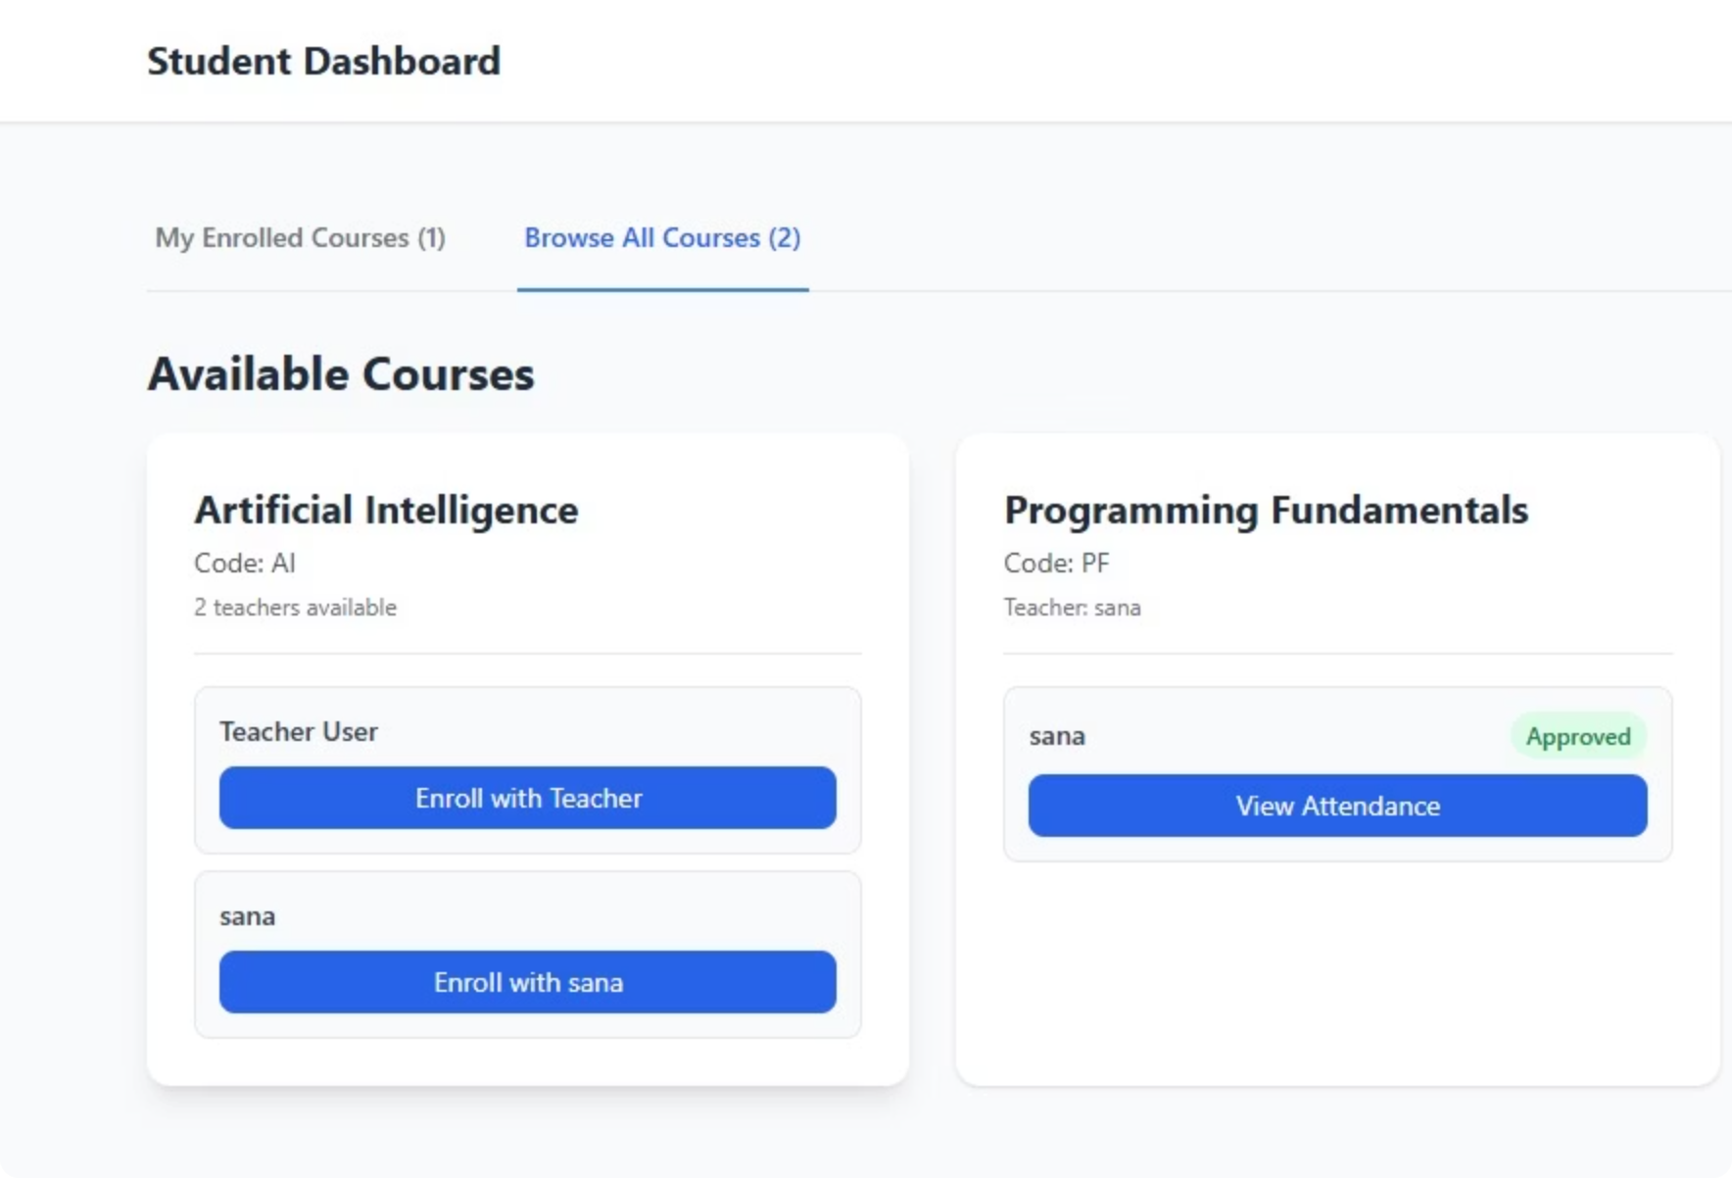

SUMMARY
Conclusion & Future Enhancements
Successfully Automated Attendance System
Our AI-Based Automatic Attendance System offers an efficient, secure, and user-friendly solution to modern attendance challenges.
Future Enhancements
Mobile App Support: Extend functionality to dedicated mobile applications for enhanced accessibility.
Liveness Detection: Integrate advanced algorithms to prevent fraudulent attendance attempts.
Cloud Deployment: Transition to a scalable cloud infrastructure for improved performance and availability.
Advanced Analytics & Reporting: Implement comprehensive data analysis and customizable reporting features for deeper insights.

